Slide 1
Language Specific Peculiarities and Webdata
Jennifer Melot
Thursday, February 16, 2017
Notes:
1
1

Slide 2
Auxiliary Babel Data Resources
Beyond training data, performers needed some other information to create their best-performing systems:
Language information, specified in the Language Specific Peculiarities (LSP) document
Webdata, scraped from the internet

Slide 3
Auxiliary Babel Data Resources
Beyond training data, performers needed some other information to create their best-performing systems:
Language information, specified in the Language Specific Peculiarities (LSP) document
Webdata, scraped from the internet

Slide 4
Why Do We Need a LSP?
Most speech recognition systems rely on a lexicon that maps words to strings of phonemes
lexicon = l E k s I k Q n / l ɛ k s ɪ k ɒ n
A good mapping is created by a language expert who has determined how each word is actually pronounced
But: performers needed to recognize additional words that were not present in the training dictionary.
The LSP provides a mapping between characters in the native writing system (orthography) and phonemes that can be used to automatically construct an approximate pronunciation for new words.

Slide 5
Phonetics in One Slide
Phonemes are the basic units of sound in a language.
Changing a phoneme changes the word (and therefore its meaning).
beet = /b i t/ vs bet = /b E t/
Phonemes have a variety of attributes, such as:
where in the mouth they are pronounced (“place”),
how the tongue shapes the airstream (“manner”), and
whether the vocal cords are vibrating as they are produced (“voicing”).
Speech recognition systems often require phoneme attributes to be specified for each language (although some systems use a purely data-driven approach).

Slide 6
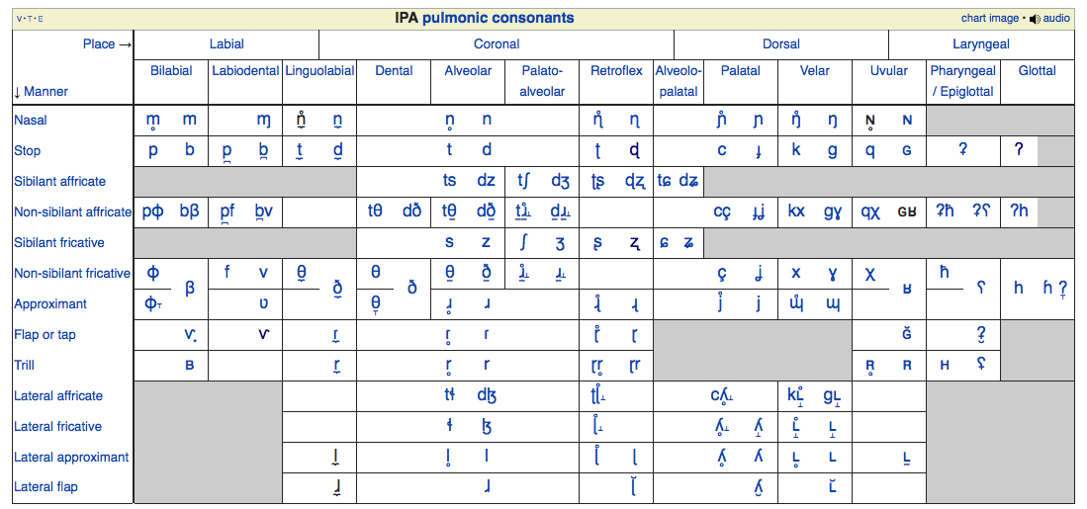
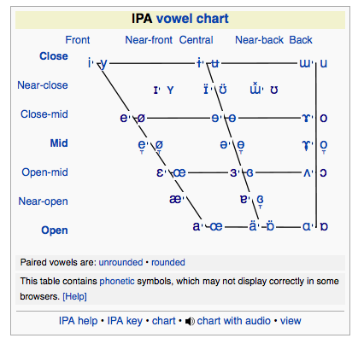
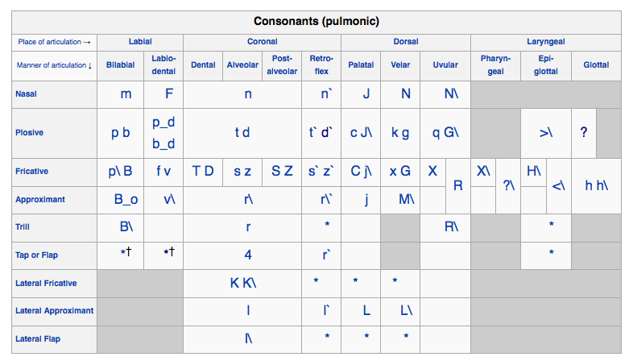
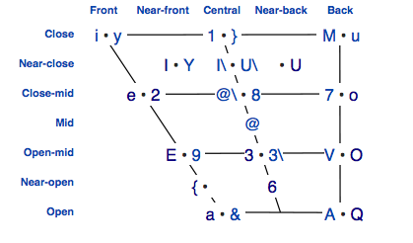
How to Write Phones?
IPA
Standard, one character per phone; many non-ASCII characters
X-SAMPA
ASCII version of IPA

Slide 7
What’s in the LSP
Information about how the language was collected
Which dialects were collected
How the language was transcribed and normalized
Typical mapping from character(s) to phone(s)
Information about language’s phonology and rare/foreign phones
Other information such as pronunciation of numbers and letters
Orthography (native writing system) | Usual Pronunciation (SAMPA)
క | k
ఖ | k_h
గ | g

Slide 8
Using the LSP for LTP (Letter to Phoneme): Babelon Input Example
The Babelon system requires the following inputs to do Letter to Phoneme mapping:
List of characters in the language. Example:
క
ఖ
గ
ఘ
ఙ
చ
ఛ
Easy to get by just putting all the unique characters in your training data in a file.

Slide 9
Using the LSP for LTP: Babelon Input Example
The Babelon system requires the following inputs to do Letter to Phoneme mapping:
List of characters in the language.
Mapping from spelled letters to phonemes. Example:
А a
Б p E
В w_c E
Г g E
Д t E
This may be given as a table in the LSP, depending on how that language was evaluated.

Slide 10
Using the LSP for LTP: Babelon Input Example
The Babelon system requires the following inputs to do Letter to Phoneme mapping:
List of characters in the language.
Mapping from spelled letters to phonemes.
Mapping from native language orthography to phonemes. Example:
А a
Б p
В v
Г g
Д t
Probable mappings are provided as a table in the LSP for Babel languages. The mappings are more clear in some languages than others.

Slide 11
Using the LSP for LTP: Babelon Input Example
The Babelon system requires the following inputs to do Letter to Phoneme mapping:
List of characters in the language.
Mapping from spelled letters to phonemes.
Mapping from native language orthography to phonemes.
Note that you may need to merge rare phone labels with other phones, as rare phones are not modeled well.

Slide 12
Using the LSP for LTP: Lorelei Input Example
The Lorelei system requires the following inputs to do Letter to Phoneme mapping:
List of characters in the language. Example:
codepoints = set([0x0027, 0x002d, 0x005f, 0x0061, 0x0062, 0x0063,
0x0064, 0x0065, 0x0066, 0x0067, 0x0068, 0x0069,
0x006a, 0x006b, 0x006c, 0x006d, 0x006e, 0x006f,
0x0070, 0x0071, 0x0072, 0x0073, 0x0074, 0x0075,
0x0076, 0x0077, 0x0078, 0x0079, 0x007a, 0x00e1,
0x00e9, ])
Similar idea as in the Babelon system, just in a different format (Python list of hexidecimal values). This would be added to grapheme.py.

Slide 13
Using the LSP for LTP: Lorelei Input Example
The Lorelei system requires the following inputs to do Letter to Phoneme mapping:
List of characters in the language.
Mapping from native language orthography to phonemes. Example:
phoneTable = [('u0061','A'), ('u0062','b_<'), ('u0064','d_<'),
('u0065','E'), ('u0066','f'), ('u0067','g_<'),
('u0068','h'), ('u0069','i'), ('u006a',r'J\_<'),
('u006b','k'), ('u006c','l'), ('u006d','m'), ('u006e','n'),
('u006f','O'), ('u0070','p'), ('u0072','r'), ('u0073','s'),
('u0079','j'), ('u007a','z'), ('u00e1','a'), ('u00e9','e'),
]
Again, similar to the Babelon system, but in a different format (Python list of tuples of hexidecimals and phone characters). This would also be added to grapheme.py.

Slide 14
Using the LSP for LTP: Lorelei Input Example
The Lorelei system requires the following inputs to do Letter to Phoneme mapping:
List of characters in the language.
Mapping from native language orthography to phonemes.
Phone feature file. Gives mapping from phones to their features, such as place and manner of articulation. Example:
4 alveolar flap voiced consonant
4_0 alveolar flap voiceless consonant
5 velarized alveolar lateral approximant consonant
5_R velarized alveolar lateral approximant rising consonant
These descriptions can be derived directly from the phone descriptions on the XSAMPA Wikipedia page and are probably already specified in models/xsampaphones.txt.

Slide 15
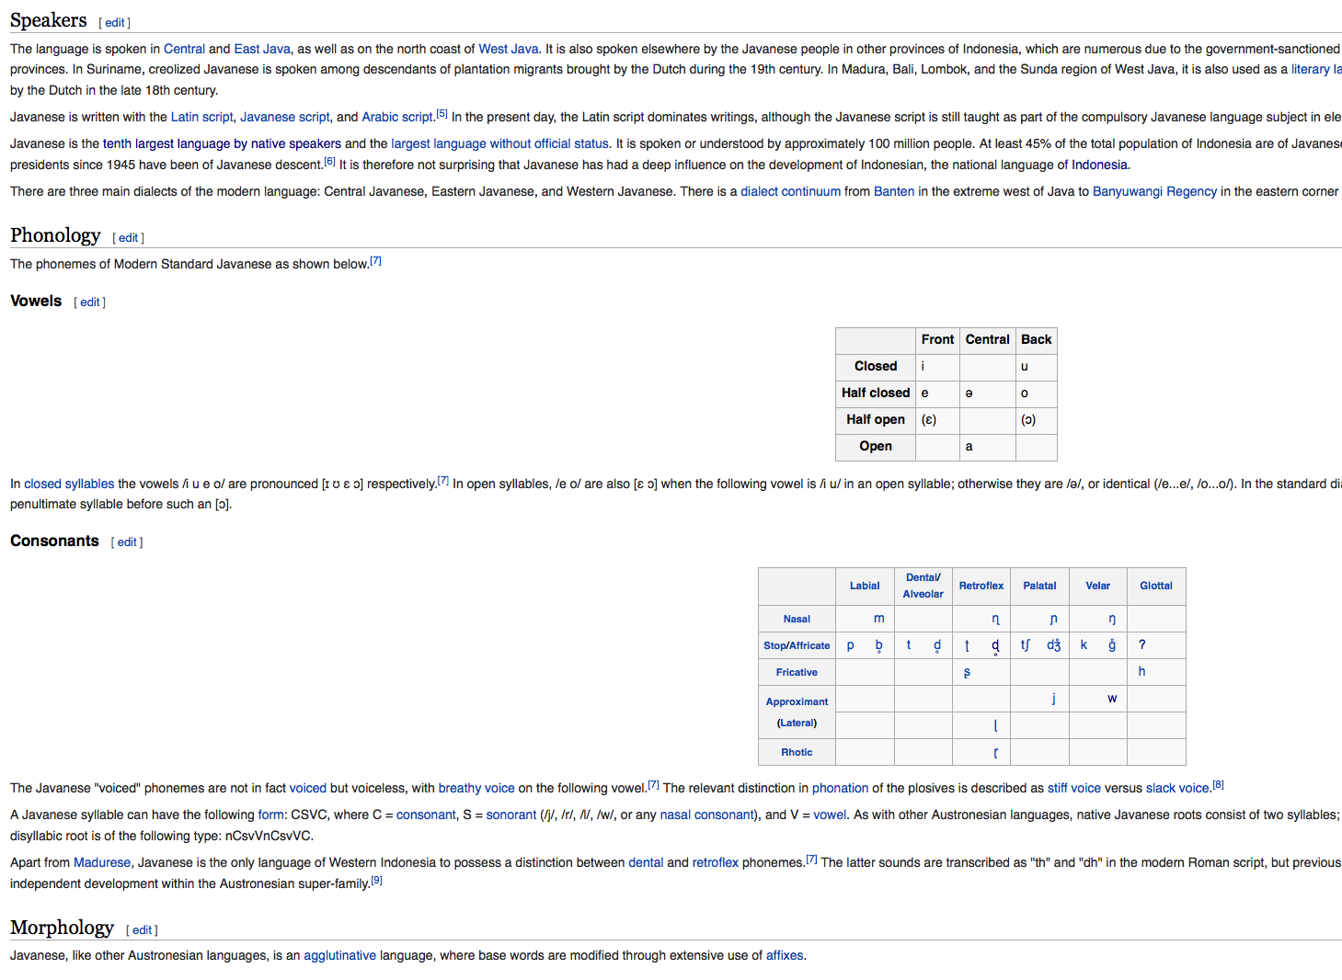
Other Language Resources: Wikipedia
Many languages have at least a basic phone chart and information on phonology, morphology, and syntax on Wikipedia
Many of these Wikipedia articles have a section that discusses rare phones and dialectical variation in pronunciation, which can be very helpful
Sometimes the articles have letter-to-phone mappings but Omniglot is more likely to have them

Slide 16
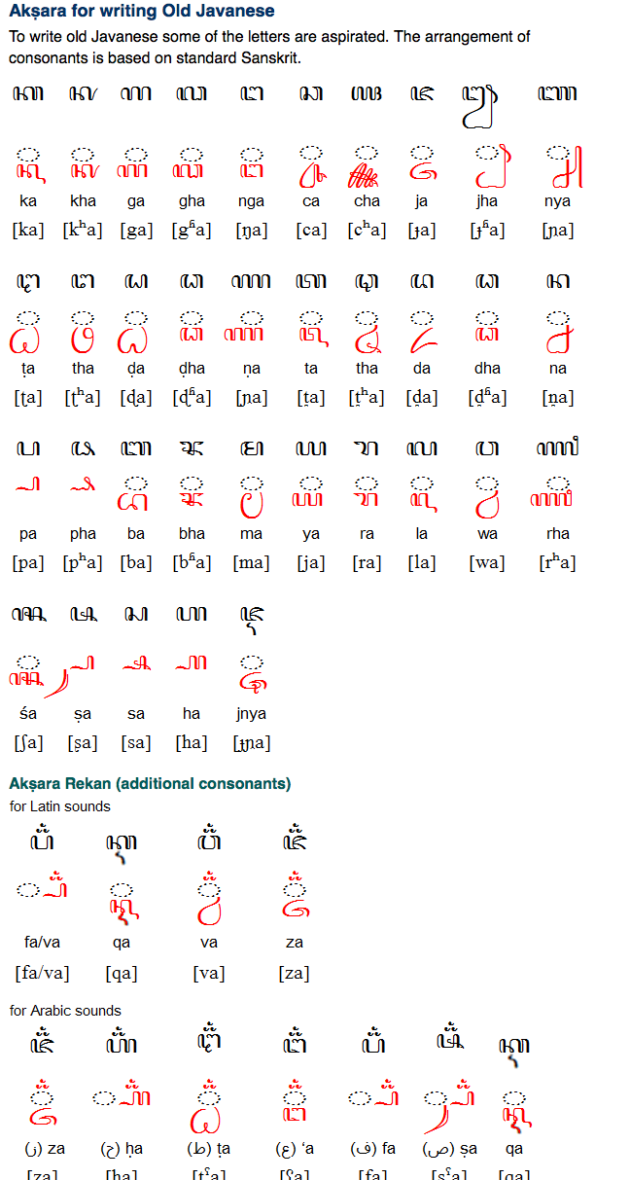
Other Language Resources: Omniglot
Has character to phone mappings for large number of languages
Limited additional information about the language

Slide 17
Auxiliary Babel Data Resources
Beyond training data, performers needed some other information to create their best-performing systems:
Language information, specified in the Language Specific Peculiarities (LSP) document
Webdata, scraped from the internet

Slide 18
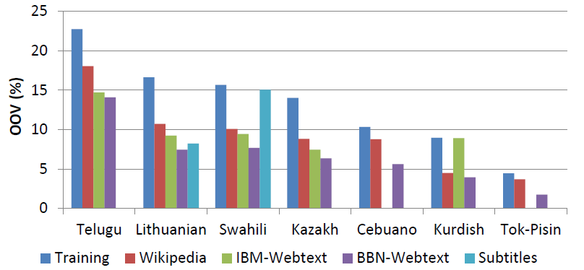
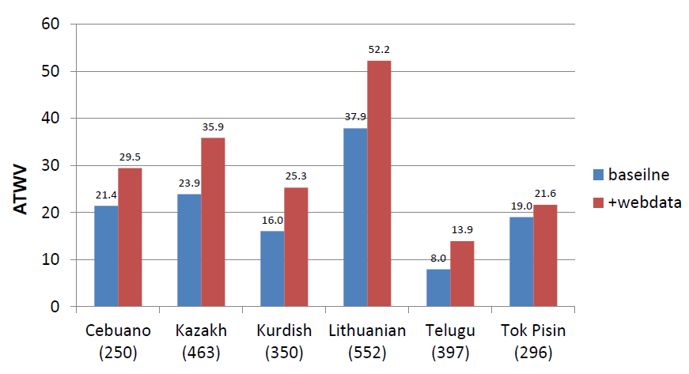
Benefits of Webdata
Gathering text from the web in your target language increases the number of words you know in that language, which can potentially reduce your number of OOVs and result in better keyword search performance.
Webdata also gives you more data to train your language model.
Effect of webdata on OOV % across languages
Development Data Keyword ATWV (OOV→IV)

Slide 19
How to Use Webdata
Different performers used the same shared webdata in different ways
Babelon:
Add 30K most frequent new words from each resource to their word list
Extract ngrams for their language models with different weightings depending on the source
Lorelei:
Add all words to word list with a count of 10 or more after normalization
Extract ngrams for their language models with different weightings depending on the source

Slide 20
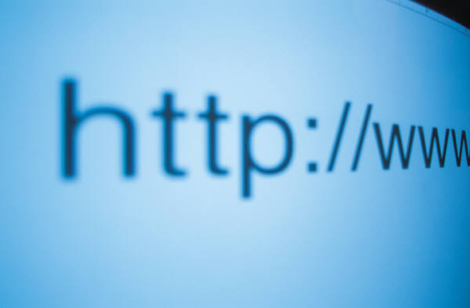
How Webscraping Works
Webscraping is the process of running computer programs that automatically:
Identify websites that may contain languages of interest
Download the text contents of those websites
Perform some form of cleanup and language ID to extract relevant parts of the web data
List of interesting search terms/data sources
Finished webdata
Develop list of websites to search
Download text contents of websites
Filter website content

Slide 21
Getting Started
If possible use VMWare to create a fresh Ubuntu 14.04 installation with at least 60 GB of disk space and 2048 MB of RAM.
You will need to subscribe to data plans from Bing and DiffBot – this will cost on the order of $700 a month, depending on how much data you decide to collect.
Both webscraping systems require some familiarity with the Linux command line.
Both webscraping systems could theoretically download malware; so just don’t execute the files you download!

Slide 22
Installing the Babelon System
The Babelon system is mostly Python and Perl based, and comes with a good README.
All required packages can be installed with:
apt-get, a Ubuntu package manager: https://help.ubuntu.com/community/AptGet/Howto
pip, a Python package manager: https://pypi.python.org/pypi/pip
Remember to only run one copy at a time.
The maximum number of transactions given for 6000 terms is an underestimate – it’s safer to use the 100,000 transaction Bing Search API plan ($125/mo).
Takes at least 60 GB to run at a level that will gather sufficient data, give the VM as much disk space as you can.

Slide 23
Running the Babelon System
Simply run the get_webdata script with parameters:
top_n_terms – Number of top ranked search terms to use.
train_transcript_dir – Directory of training transcripts. Expects a directory of files in the Appen transcription format.
dev_transcript_dir – Directory of dev transcripts. Expects a directory of files in the Appen transcription format.
The script can restart from checkpoints but cannot output partial results, so make sure you have enough time/space to run it.
Output is two directories of webtext, one LID filtered and one unfiltered, and two text files with statistics on the collection. One has general statistics on the collection, such as word counts and number of URLs queried. The other has OOV reduction numbers (relative to dev).

Slide 24
Example summary.txt Statistics
language: surprise
Number of search terms: 10
Number of raw URLs: 4,798
Number of unique URLs: 3,714
Number of retrieved webpages: 3,530
Average retrieved webpages per search term: 353
Average raw words per search term: 505,849
LID threshold: 0.05
Average lid-filtered words per search term: 111,577
Raw word count: 5,058,494
LID filtered word count: 1,115,771
LID text extraction ratio: 22.06%
LM web selected word count: 1,041,890
LM web weight: 0.322906
LM train weight: 0.677094
LM web perplexity on dev: 1051.35
LM train perplexity on dev: 502.337
LM web+train perplexity on dev: 321.602

Slide 25
Example oov.txt Statistics
#language new_words oov_dev_set
surprise 0 41.55
surprise 5000 14.23
surprise 10000 11.68
surprise 15000 9.67
surprise 20000 8.52
surprise 25000 8.09
surprise 30000 7.85
surprise 35000 7.73
surprise 40000 7.54
surprise 45000 7.06
surprise 50000 7.00
surprise 55000 7.00
surprise 60000 7.00
surprise 65000 7.00
surprise 70000 7.00
surprise 75000 7.00
OOV reduction plateau

Slide 26






Installing the Lorelei System
Mostly Java-based
Has a number of dependencies: Maven, Mongo, Google Compact Language Detector (CLD)
Uses a number of different data sources: TED, Blogspot, Wikipedia, Wordpress, Twitter, and YouTube subtitles. To collect from all these sources, need:
DiffBot API key ($299/mo for $250,000 calls/mo)
Twitter API keys (free)
Google Custom Search Engine keys (free)
Bing Search API key ($200/mo at 100,000 transactions/mo)

Slide 27
Seeding the Lorelei System
There are three ways to generate the seed word list of the most common words in a language:
Run a Python script to generate the list from the BABEL FLP data
Download the Leipzig Corpus for the language if it exists and use the languageCode-sentences.txt file
Use langCode-words.txt from the Crubadan Project data for the language
The Lorelei recommendation is to use the Crubadan data along with the FLP data.

Slide 28
Running the Lorelei System
There are many possible parameters – see section (3) of the Readme file that accompanies the code. Some special notes:
Wikipedia collection requires you to download an xml dump of Wikipedia for the language.
The DiffBot collection requires that the Blogspot collection be completed, which takes at least a day (it fetches the full content of blogs found in the Blogspot collection).
The Twitter Users collection requires that the Twitter collection be complete, also takes at least a day. It fetches the full content of Twitter user timelines, for users that were found in the initial Twitter collection.
Twitter, Forum Posts, and Blog Posts are saved to the database and must be exported to JSON form.

Slide 29
Summing up LSPs and Webdata
A good system is robust to unseen data
Language-specific pronunciation mappings from an LSP can help you deal with unseen words with unknown pronunciations
Webdata can help you train a better language model and have fewer out of vocabulary words

